Slide 3
Note:
In today’s presentation, whenever you see text in light blue please look at your notes for a place to copy down the information shown. Other text may be interesting or important and you may wish to copy it as well, but it is optional to do so. However, please be sure to copy the light blue into your notes.
Thank you.

Slide 4
In many ways ancient Rome was very advanced.
These advancements improved the quality of their everyday life.
Some of their advancements solved everyday problems, and some were simply pleasing to the eye.

Slide 5
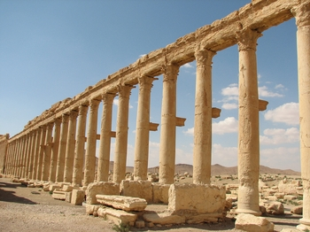
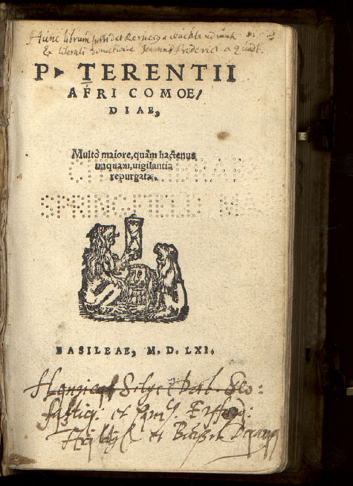
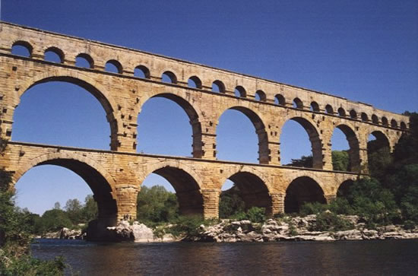
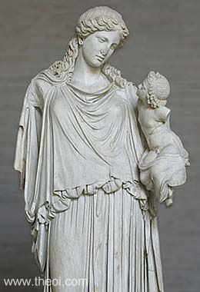
Architecture
Literature
Arches
Sculptures/Art
Structures

Slide 6
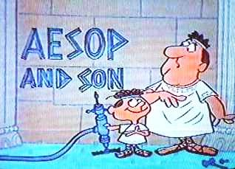
Literature

Slide 7
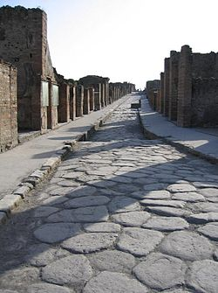
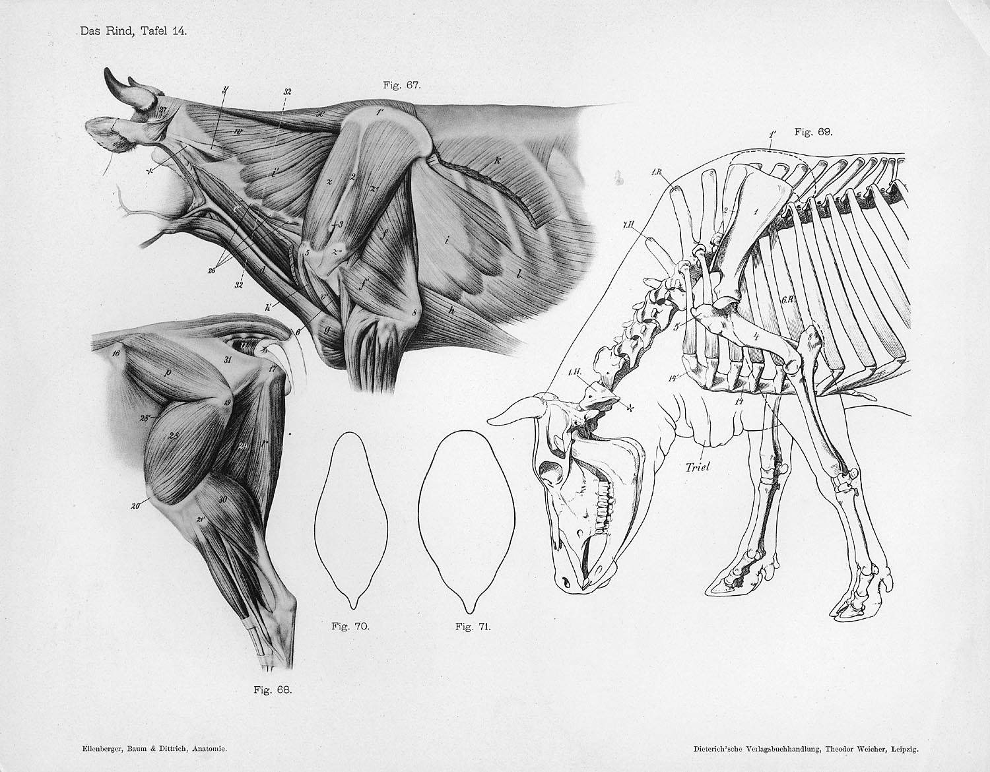
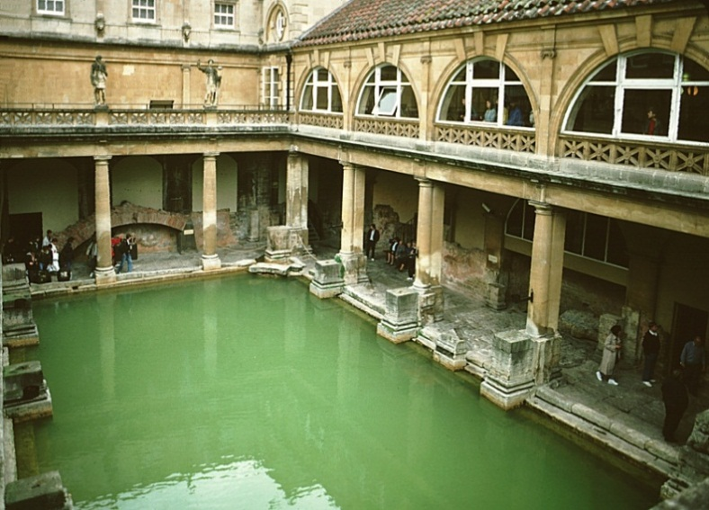
Roads
Astronomy
Public Baths
Anatomy

Slide 8
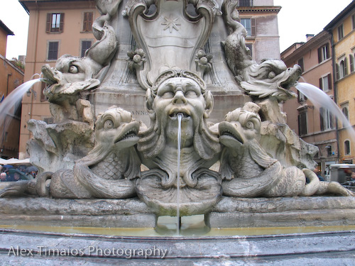
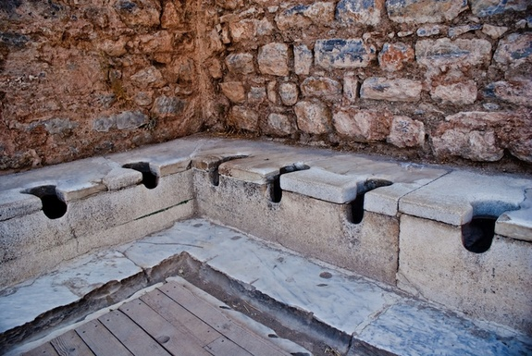
Fountains
Public Toilets

Slide 9
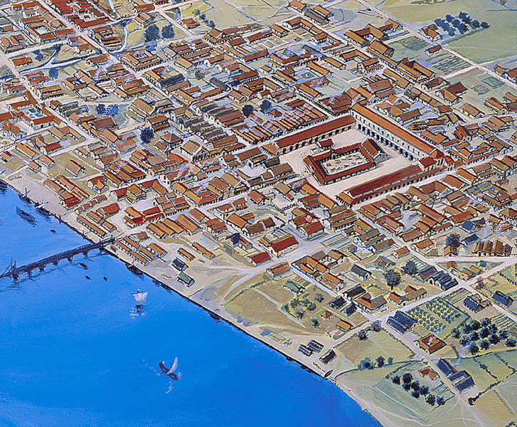
City Layout
The layout of streets and locations of public buildings greatly influenced the quality of daily living.

Slide 10
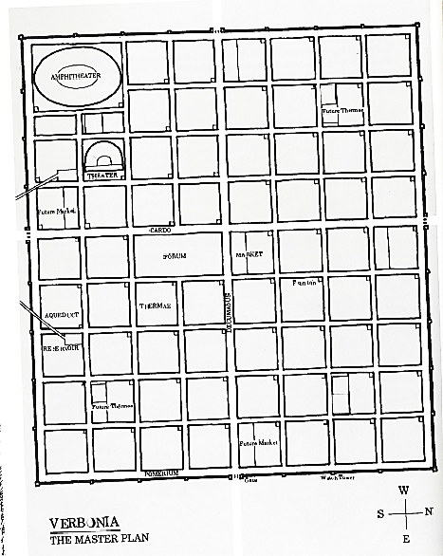
City streets were at right angles to one another. A forum was located in the middle of the city which served as a market place and a center for government and business.

Slide 11
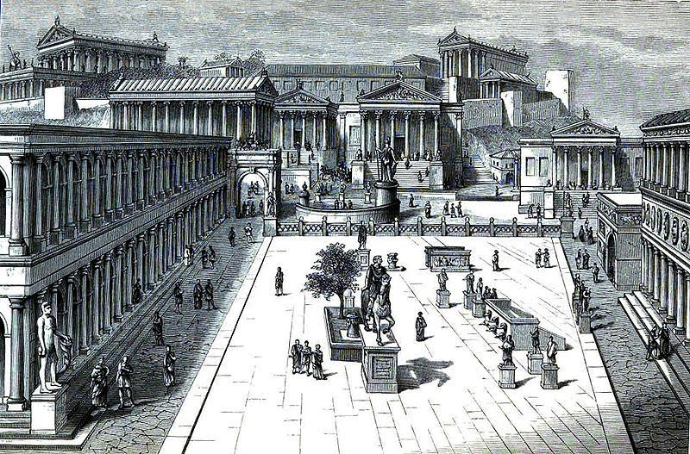
The Forum—Was a special place where Romans met to sell and buy goods, worship the gods, do business, and to conduct government matters.

Slide 12
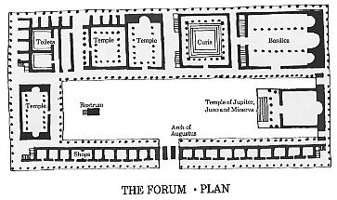

Slide 13
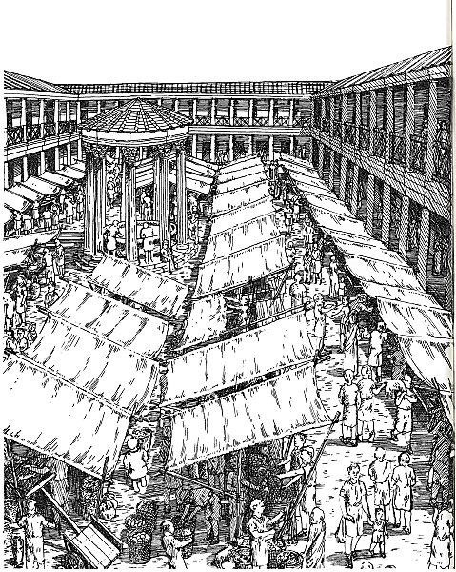

Slide 14
Other buildings and structures within the city included many roads, homes, apartments, shops, public baths and toilets, amphitheaters, arenas, temples, and markets.

Slide 15
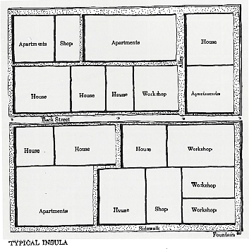

Slide 16
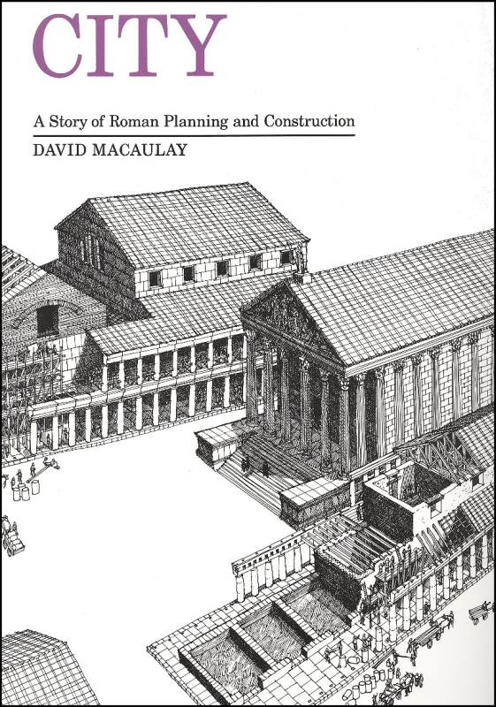
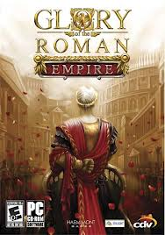

Slide 17
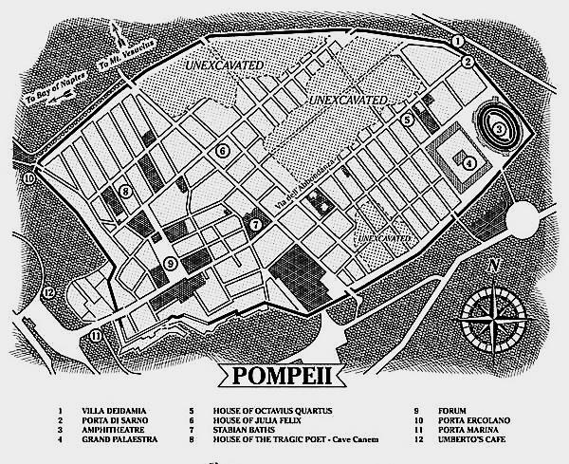

Slide 19
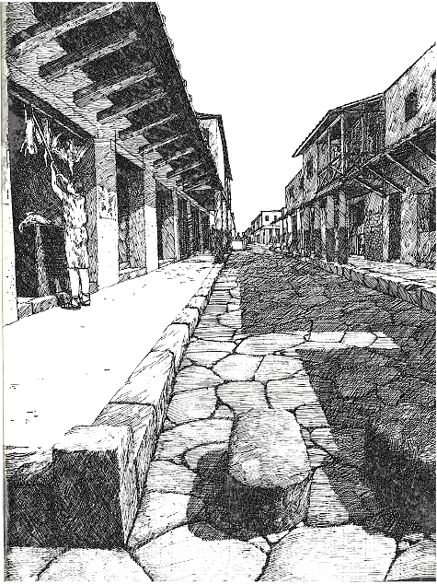
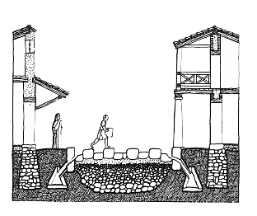

Slide 20
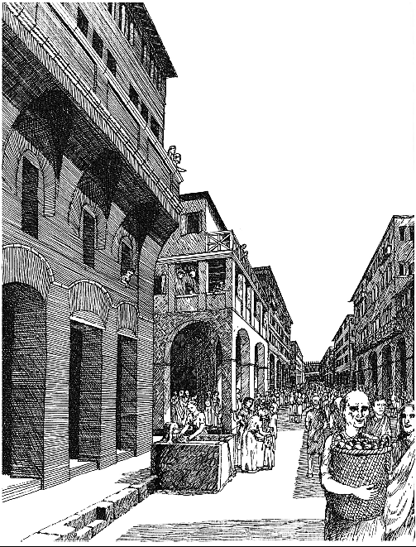

Slide 21
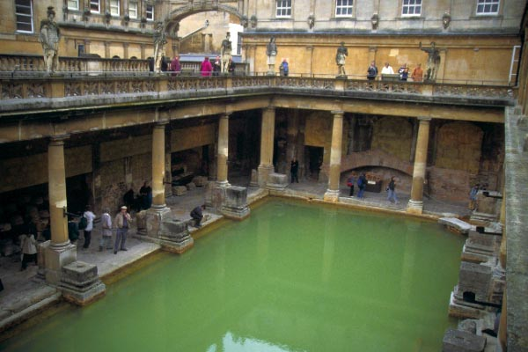

Slide 22
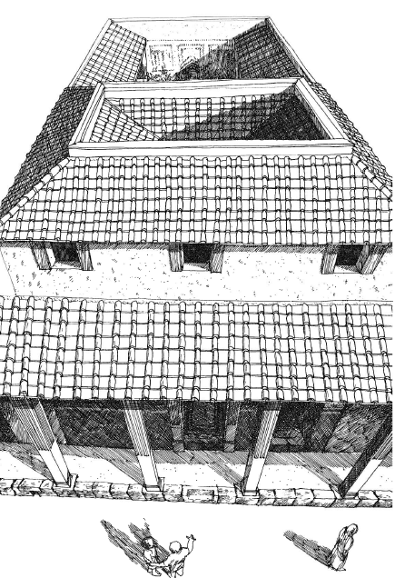
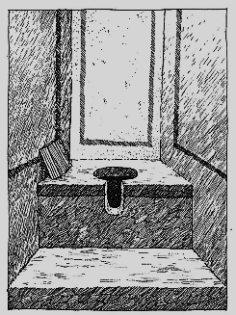

Slide 23
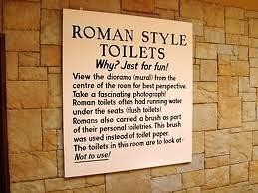

Slide 24
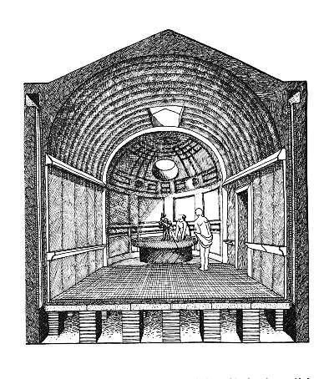
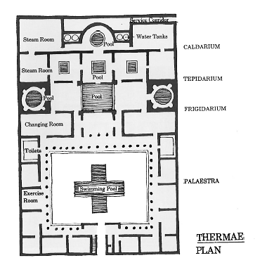

Slide 25
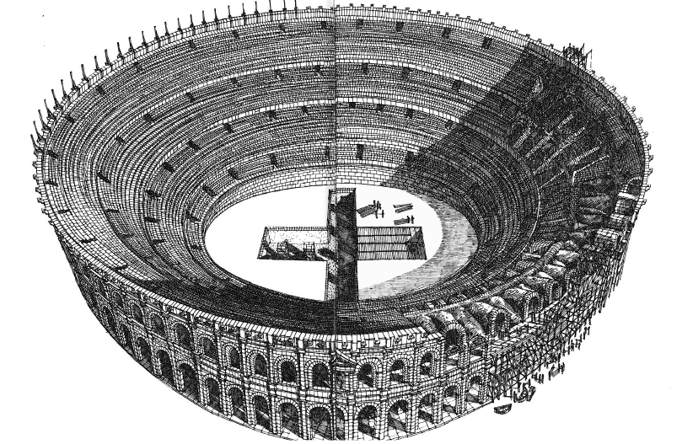

Slide 26
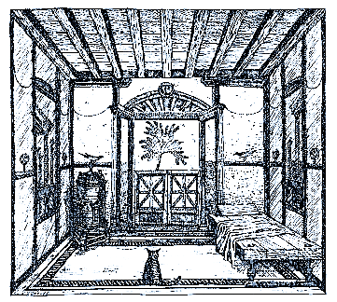
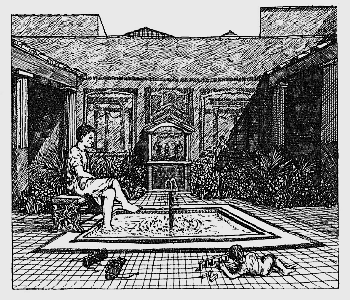

Slide 27
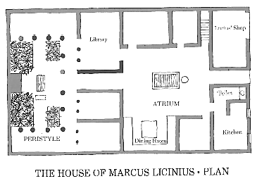
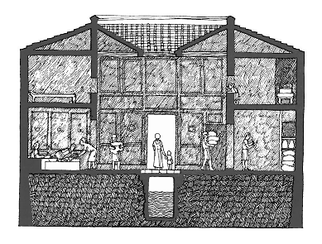

Slide 28
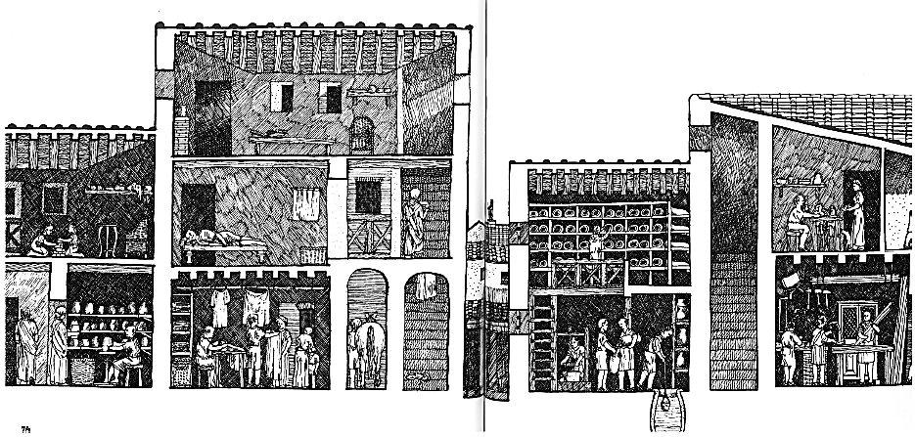

Slide 29
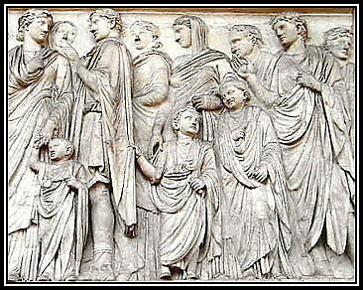
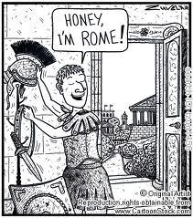
Family Life
Paterfamilias was a term that meant the father was the head of the household and had the final say in all matters.

Slide 30
Family Living
Pater (father) was head of the family
Extended families lived together
Pater arranged the marriages of his children
Pater was responsible for his children’s education
Children were educated at home or at a school if they were rich.
At age 14-16 boys burned their toys, wore togas and became men.
Girls became women when they got married.
Older girls went to school but also learned household duties.

Slide 31
(Click On Picture)

Slide 32
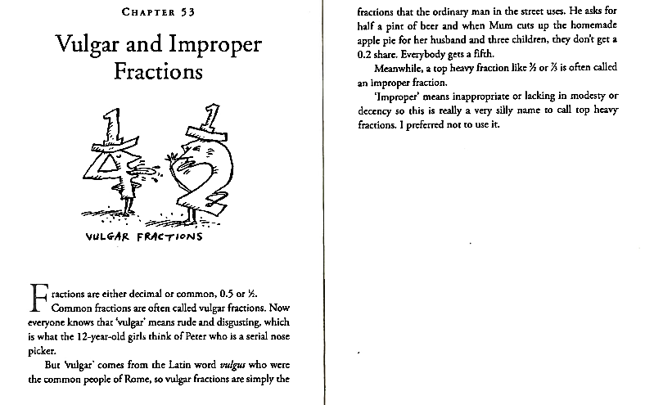
Math-Alert

Slide 33
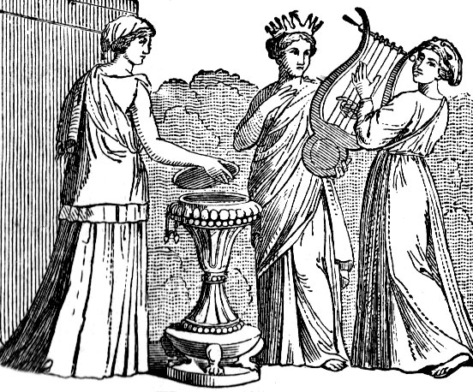
Roman Women

Slide 34
Roman Women
Had some rights, but weren’t full citizens
Women had a strong influence on their families
Paterfamilias (father) controlled her affairs
Wealthy women had more freedom than poor women
Wealthy women could own and sell land, and run a business

Slide 35
Roman Religion
Romans worshiped many gods and goddesses. They also believed that spirits lived in natural things, like trees and rivers.
Roman gods and goddesses were derived (taken) from the ancient Greeks.
Ancient Romans worshiped by praying and offering food.
Roman homes had an alter to worship household gods.

Slide 37
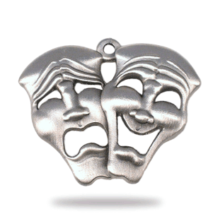
Ancient Roman Humor
A barber, a bald man and an absent-minded professor were taking a journey together. They have to camp overnight, so they decide to take turns watching the luggage. When it’s the barber’s turn, he gets bored, so amuses himself by shaving the head of the professor. When the professor is woken up for his shift, he feels his head, and says: “How stupid is that barber? He’s woken up the bald man instead of me.”
1) A barber, a bald man and an absent-minded professor were taking a journey together. They have to camp overnight, so they decide to take turns watching the luggage. When it’s the barber’s turn, he gets bored, so amuses himself by shaving the head of the professor. When the professor is woken up for his shift, he feels his head, and says: “How stupid is that barber? He’s woken up the bald man instead of me.”
2) A man meets an acquaintance and says: “It’s funny, I was told you were dead.”. He says “well, you can see I’m still alive.” But the first man disputes this on the grounds that “the man who told me you were dead is much more reliable than you.”

Slide 38
The End

